Slide 1




Grammar Toolkit
Adverbs
What are adverbs?

Slide 2
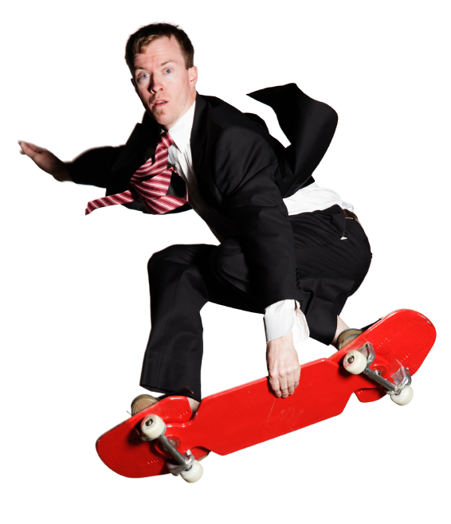
Grammar Toolkit
Adverbs
An adverb adds meaning to a
verb, adjective or another adverb. It answers
a question: How? When? Where? or Why?
noun
verb
adjective
noun
Simon rode his bright red skateboard extremely well yesterday.
How red is the skateboard?
When did Simon ride?
How did Simon ride?
How well did Simon ride?
It is bright red.
He rode yesterday.
He rode well.
He rode extremely well.

Slide 3
Grammar Toolkit
Adverbs
Find the adverb in each sentence.
What information does it give?
Yuri waited there for 20 minutes.
The big match is tomorrow.
Riley’s grandfather is very old.
Chantal always arrives on time.
The canoe drifted lazily down the river.
tells where
tells when
tells how much
tells how
tells how
Many adverbs end in ly

Slide 4
Grammar Toolkit
Adverbs
Remember, adverbs give meaning to verbs,
adjectives and other adverbs — not to nouns. Match the adjectives and adverbs with each sentence.
real or really?
The class has done well.
really
The hair is !
real
good or well?
You’ve done .
well
It’s a result.
good
bad or badly?
No one did .
badly
No one gets a report.
bad
perfect or perfectly?
The project worked .
perfectly
What a result!
perfect

Slide 5
Grammar Toolkit
Adverbs
An adverb adds meaning to a verb, adjective or another adverb.
In the following sentence, the adverbs are red: Are you really sure that the season ends tomorrow?

Slide 6
Grammar Toolkit
Adverbs
The End

