Slide 1




Grammar Toolkit
Verbs
What are verbs?

Slide 2
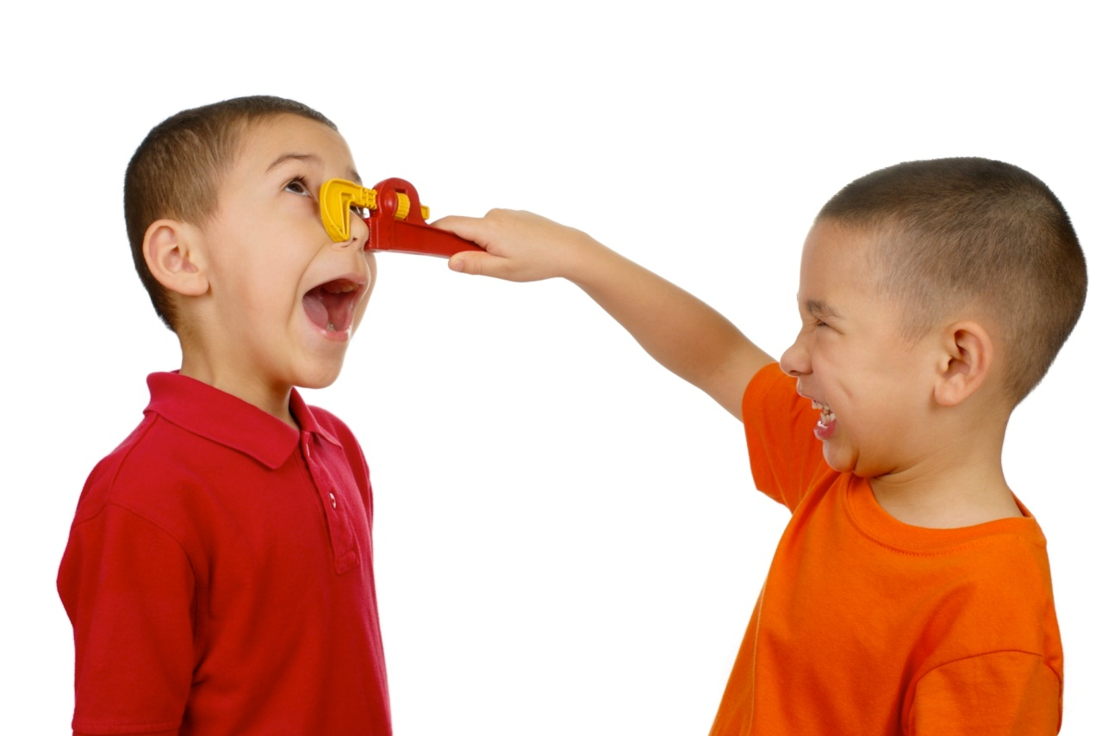
Grammar Toolkit
Verbs
A verb shows action or being.
It can be a
doing word,
being word,
having word,
saying word
or thinking word.
I squeezed Raoul’s nose.
I have a red wrench.
He is unhappy.
Raoul shouted loudly.
I love my brother.

Slide 3
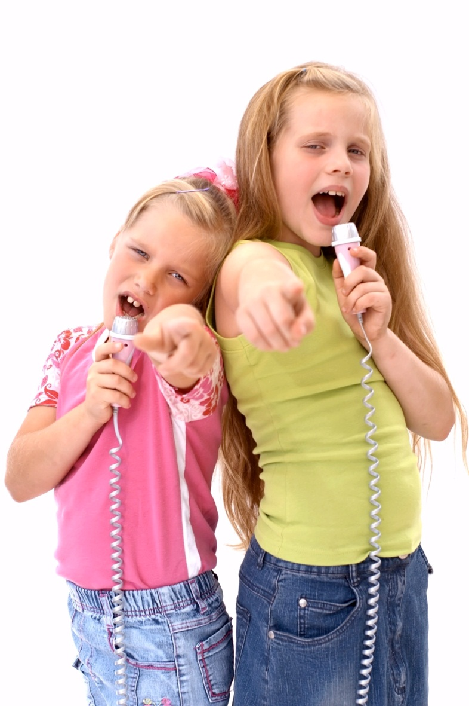
Grammar Toolkit
Verbs
Which words are verbs? Ask yourself
if the word is about action or being.
song
sang
cried
beach
lamp
read
listen
hair
weak
week
shook
bake
believe
give
jog
scooter
was
candy
whisper
listen
desk
carry
skip
toad

Slide 4
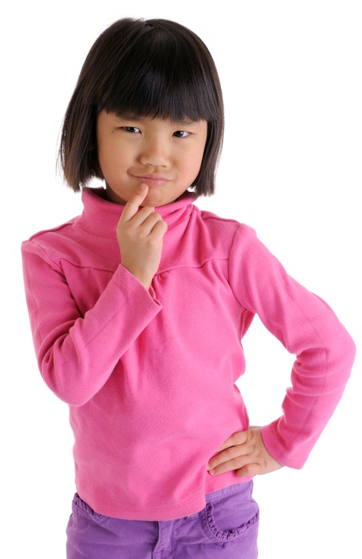
Grammar Toolkit
Verbs
Where do these verbs belong?
replied
skate
scream
know
wash
is
has
wish
was
had
doing verbs
being verbs
having verbs
saying verbs
thinking verbs

Slide 5
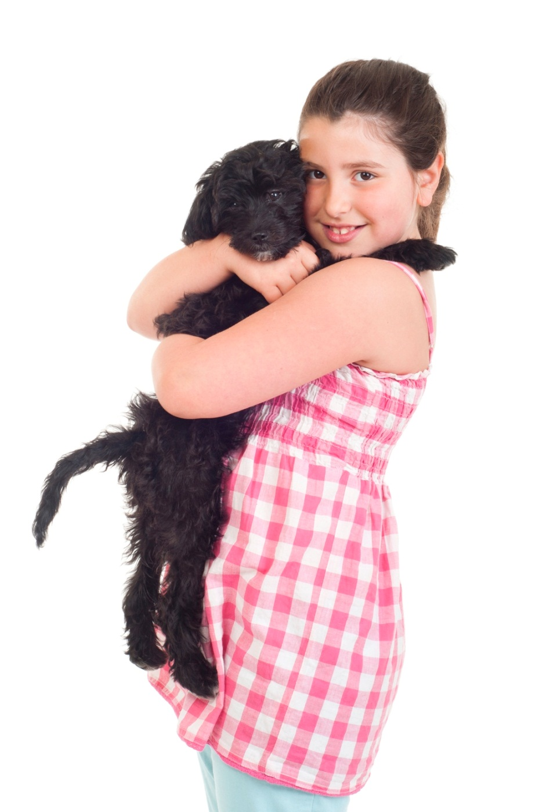
Grammar Toolkit
Verbs
In a sentence, a verb needs somebody
or something to do the action. The doer
is called the subject of the verb.
Stella hugs the puppy.
the verb
Who or what is hugging? Stella is the subject of the verb.
A verb may act on a person or thing. If it does, that person or thing is called the object of the verb.
Who or what is being hugged? The puppy is the object of the verb.

Slide 6
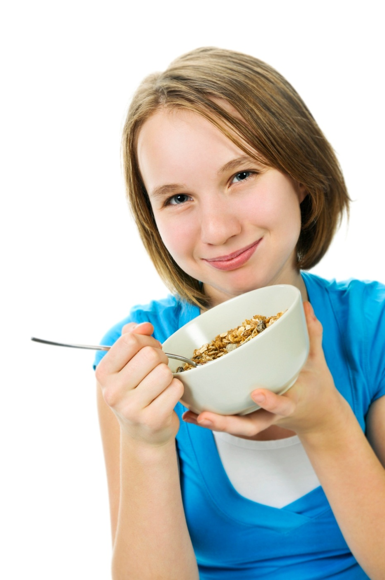
Grammar Toolkit
Verbs
What are the verbs, subjects and
objects in these sentences?
I eat broccoli.
My sister likes cereal.
Dad started the engine.
Lauren drives an old car.
Natalia sang beautifully.
A verb doesn’t need an object.

Slide 7
Grammar Toolkit
Verbs
A verb shows action or being. They are doing words, being words, having words, saying words and thinking words.
In a sentence, the person or thing doing the action of the verb is the subject of the verb.
If the verb acts on a person or thing, that person or thing is called the object of the verb.

Slide 8
Grammar Toolkit
Verbs
The End

